Slide 1
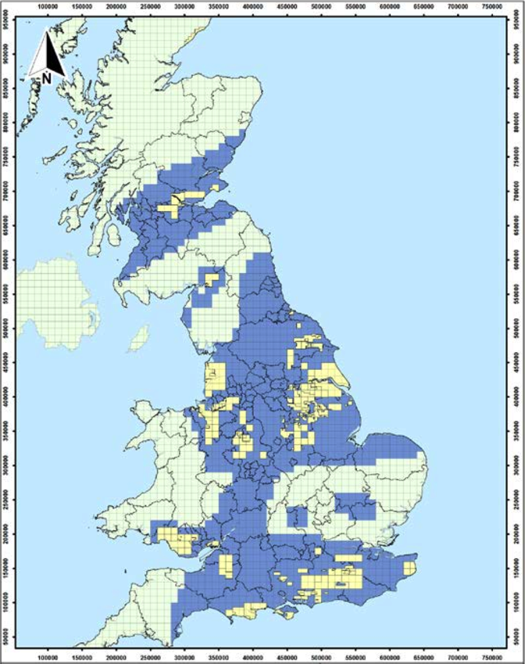
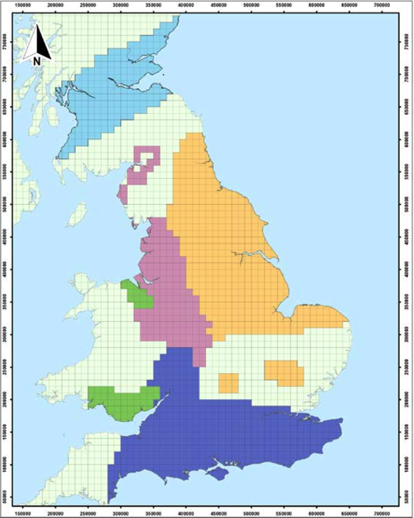
NTS 1
This PowerPoint is used just to read the map, square by square, and facilitate the creation of the data.csv file.
The areas under consideration appear to have been defined by DECC as 10,000 x 10,000 squares, matching exactly the OS’ easting/northing grid.
The existing licences have more irregular shapes, much more difficult to measure from the map. Even zooming-in in the original PDF you can’t get to a level where the borders are clear.
Anyone who knows if the data behind these maps is available in a readable format is very welcome.
NTS 2

